Slide 1
Story
Static outdoor cameras are everywhere and are a potential resource
(applied) Environmental information
(interesting to Computer Vision folks) Better understanding natural variations in outdoor scenes
Using this resource requires knowledge about the camera
AMOS dataset
Show how we calibrate cameras
Calibration is difficult because we do not control the cameras
Natural variations are interesting

Slide 2
Using natural cues to geo-locate and geo-orient distributed cameras
Nathan Jacobs, Nathaniel Roman, and Robert Pless
Washington University in St. Louis

Slide 3
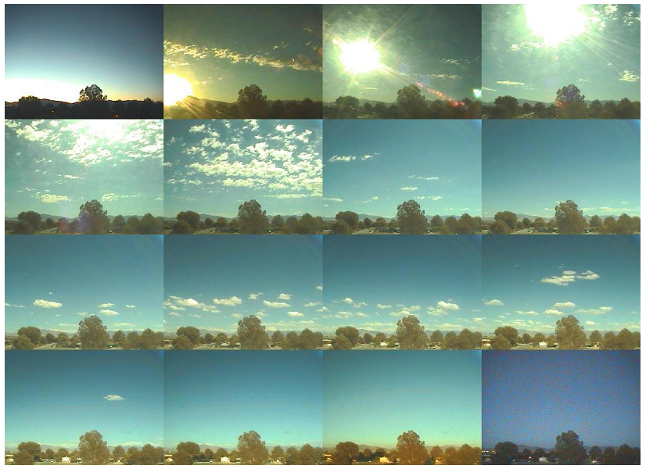

Slide 4
Archive of Many Outdoor Scenes

Slide 5
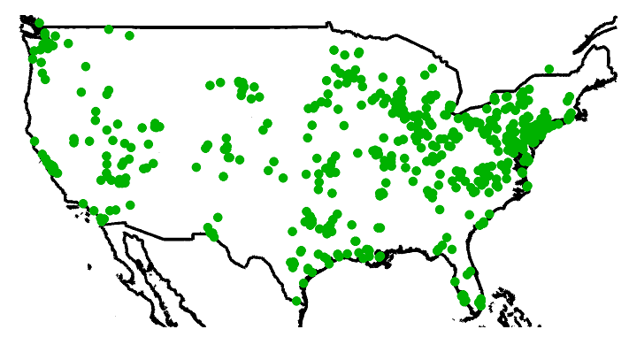
Camera locations

Slide 6
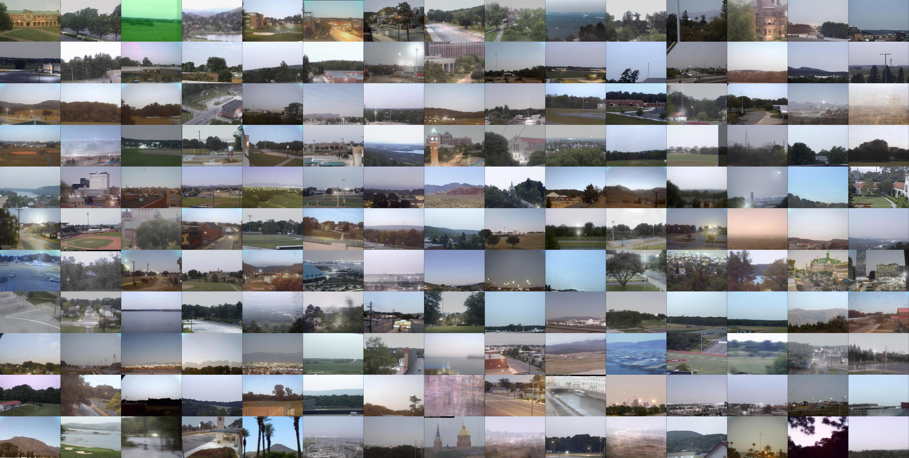

Slide 7
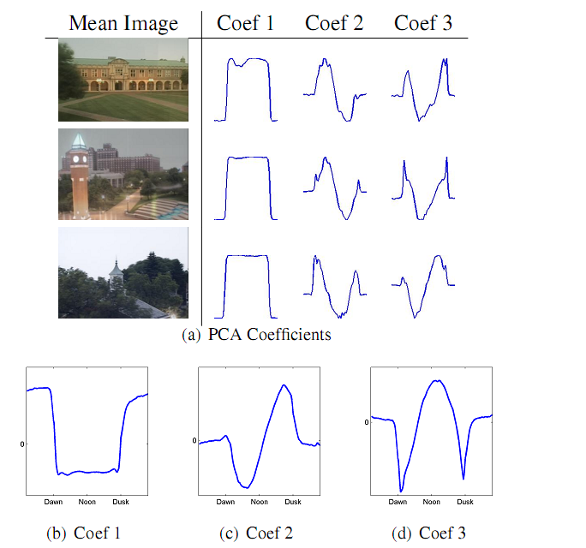

Slide 8
Canonical Day Components
Show components… show how they are solved for

Slide 9
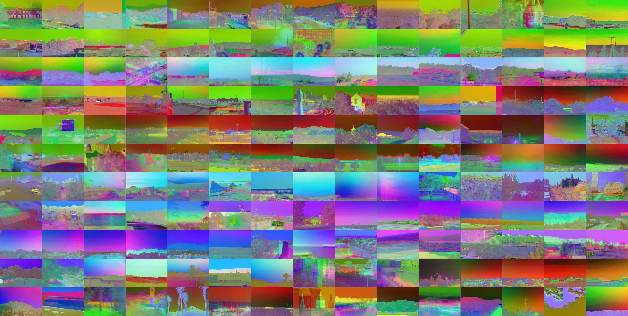

Slide 10
Geolocating

Slide 11
Algorithm Overview
1. Compute principal component coefficients of a set of images from the camera.
2. Attempt to reconstruct each map pixel trajectory with the leading k coefficients trajectories from the image set.
3. The map pixel with the highest correlation with the reconstruction is the estimate of the location of the camera.

Slide 12
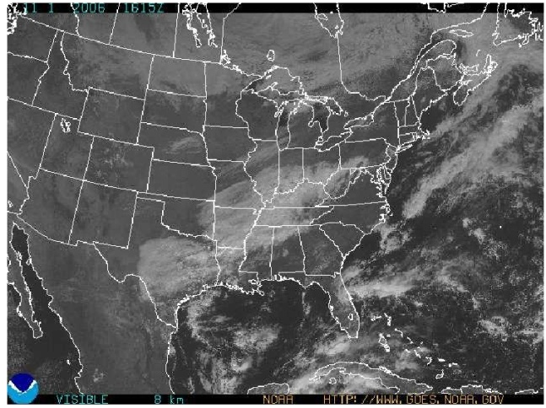
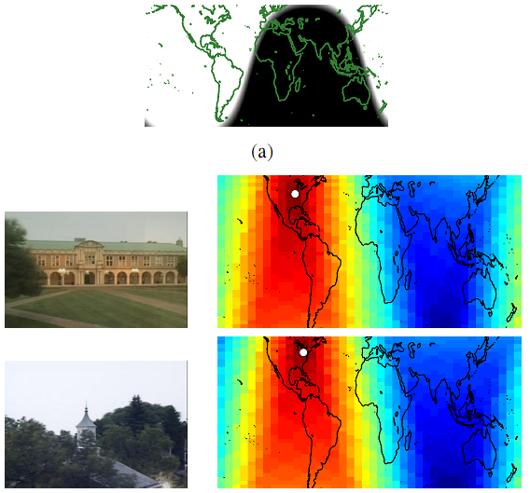
Localize the camera

Slide 13
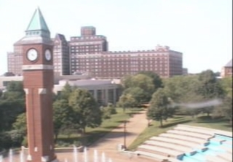
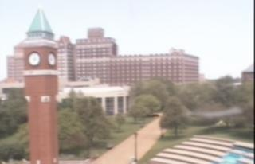
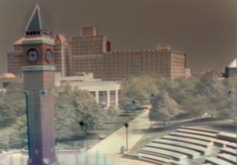
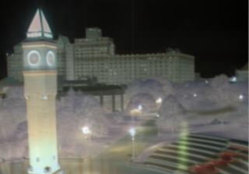
PCA coefficients
= + f₁(t,x) + f₂(t,x) + ...
Mean Image
Component 1
Component 2

Slide 14
Results
An image from a camera that was accurately localized.

Slide 15
The linear relationship between distance and canonical correlation.

Slide 16
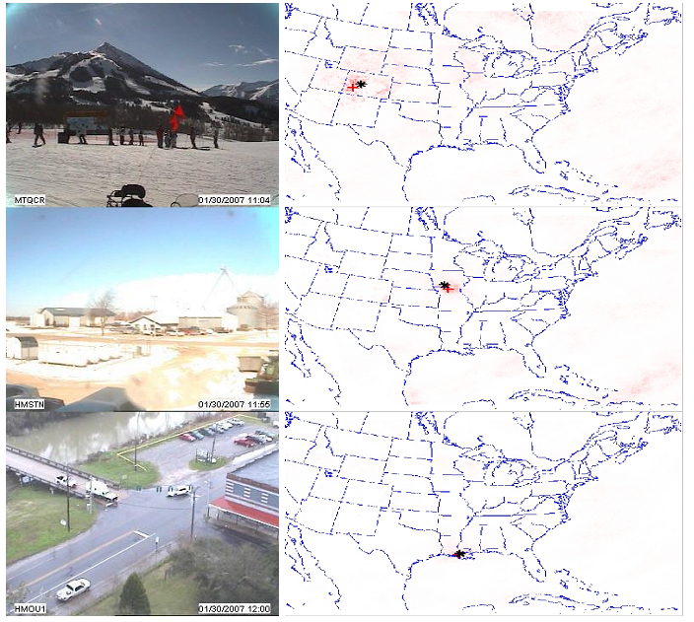

Slide 17
Can this work for other input types?

Slide 18
Geoorienting

Slide 19
Sky Segmentation
Explain how we do it…

Slide 20
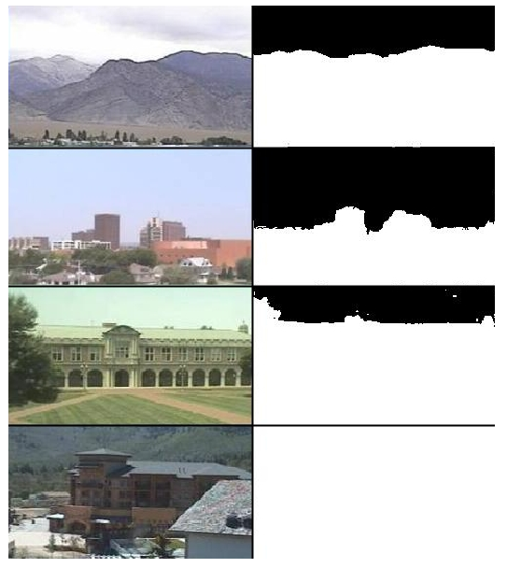
Sky Segmentation

Slide 21
Geoorienting
Explain how we do it…

Slide 22
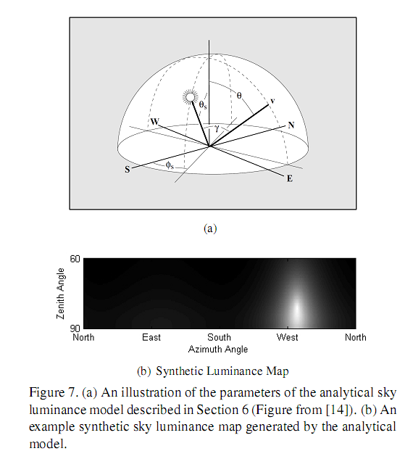
Generate Synthetic Sky Image
CITE this figure
Make video for the bottom

Slide 23
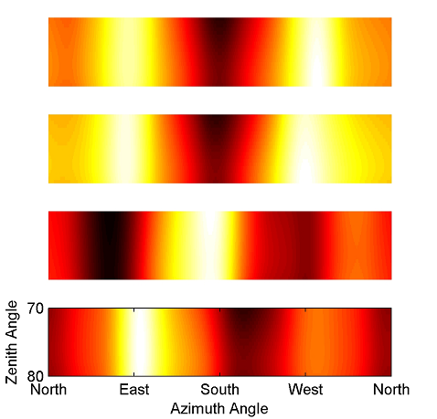
Results
Look it kinda works.

Slide 25
Acknowledgements
Supported by NSF Career award IIS-0546383.

